Slide 1
MCA MINI PROJECT
AI & TECH JOB
MARKET ANALYSIS
Data-driven insights into skills, locations and salary patterns
Presented by: VISHALI K (2025MCA58)
Under the Guidance of Mrs. S. Selvarani, M.C.A., M.Phil., NET, SET, (Ph.D.)

Slide 2
Project Overview
What the project studies and delivers
Aim
Dataset
Analysis
Identify demanded skills, job locations and salary patterns.
12,140 AI and technology job postings from two Excel datasets.
Python cleaning, SQLite storage and 18 SQL queries.
Outputs
Career Finder
12 charts and a Power BI dashboard.
Website features: login, skill tests and job matching.
2

Slide 3
Software Requirements
Tools used to develop and analyse the project
Jupyter Notebook
Python + pandas
Matplotlib
Environment for writing and running Python code.
Data cleaning, transformation and preparation.
Creating charts for data exploration.
SQLite + SQL
Power BI
HTML, CSS, JavaScript
Storing cleaned data and analysing it with queries.
Building the interactive analytics dashboard.
Creating the Career Finder website.
3

Slide 4
Proposed System
A complete workflow from raw data to career exploration
Clean the two Excel datasets using Python and pandas.
Store the prepared data in an SQLite database.
Run 18 SQL queries to analyse skills, cities and salaries.
Present findings using 12 charts and a Power BI dashboard.
Provide a Career Finder website with login and skill tests.
Rank jobs, internships and companies by skill match.
4

Slide 5
System Flow Diagram
The sequence of processing and presenting job market data
Excel
Datasets
Python
Cleaning
SQLite
Database
SQL
Analysis
Charts +
Power BI
Career Finder
Website
➜
➜
➜
➜
➜
Raw postings are cleaned, stored, queried and visualized. The website then presents career-related features to users.
5

Slide 6
Project Modules
Each module performs a specific task
Data Cleaning
SQL Analysis
Visualization
Prepares both datasets using Python.
18 queries for skills, cities and salary.
12 charts and a Power BI dashboard.
Career Finder
Skill Tests
Matching
Login and career information.
Tests SQL, Python, Statistics, ML and Power BI.
Ranks jobs, internships and companies by skill match.
6

Slide 7
Key Findings
Results reported by the project dataset
28.1%
24.6%
13.1%
Machine Learning (ML)
SQL
Python
22.3%
₹20.2 LPA
₹12.5 LPA
Bengaluru share of openings
Gurugram median salary
Median of postings with disclosed salary
8.2%
Postings that disclose salary
Note: Salary findings are based on postings that disclose salary; only 8.2% of postings disclose pay.
7

Slide 8
Career Finder — Website Pages
Sample outputs shown in the original presentation
Login
Careers
Skill Tests
Entry point for users.
Explore technology career paths.
Assess knowledge across five topics.
Jobs
Internships
Companies
Browse job opportunities.
Explore student and fresher opportunities.
Browse companies and opportunities.
8

Slide 9
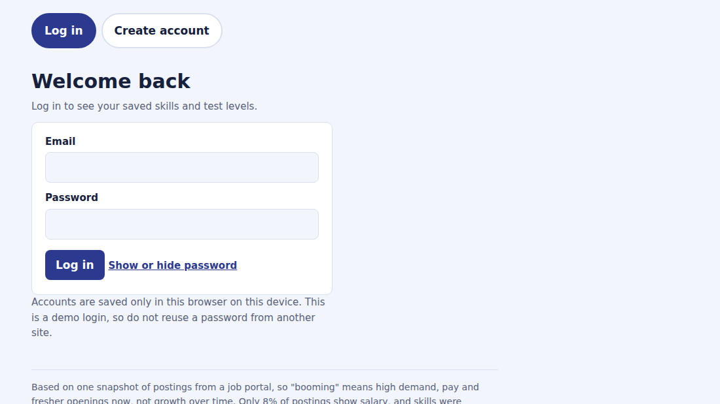
SAMPLE OUTPUT: LOGIN PAGE
5

Slide 10
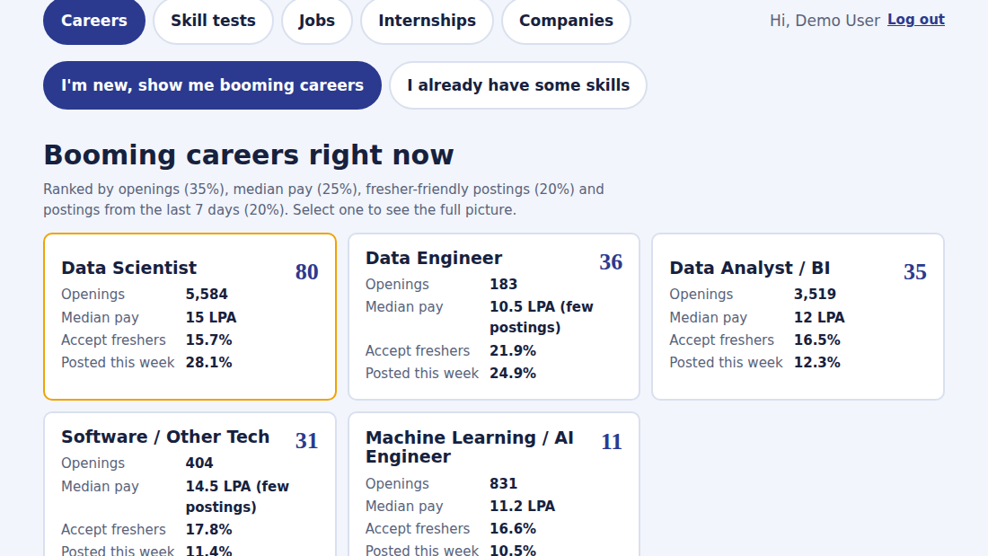
SAMPLE OUTPUT: CAREERS PAGE
5

Slide 11
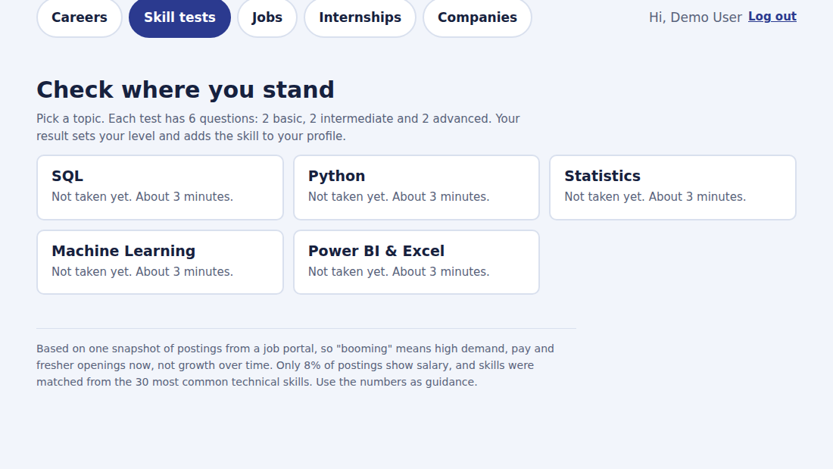
SAMPLE OUTPUT: SKILL TESTS PAGE
5

Slide 12
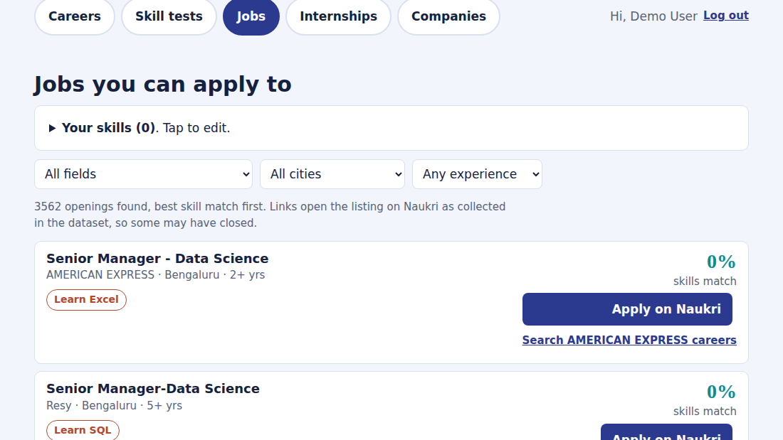
SAMPLE OUTPUT: JOBS PAGE
5

Slide 13
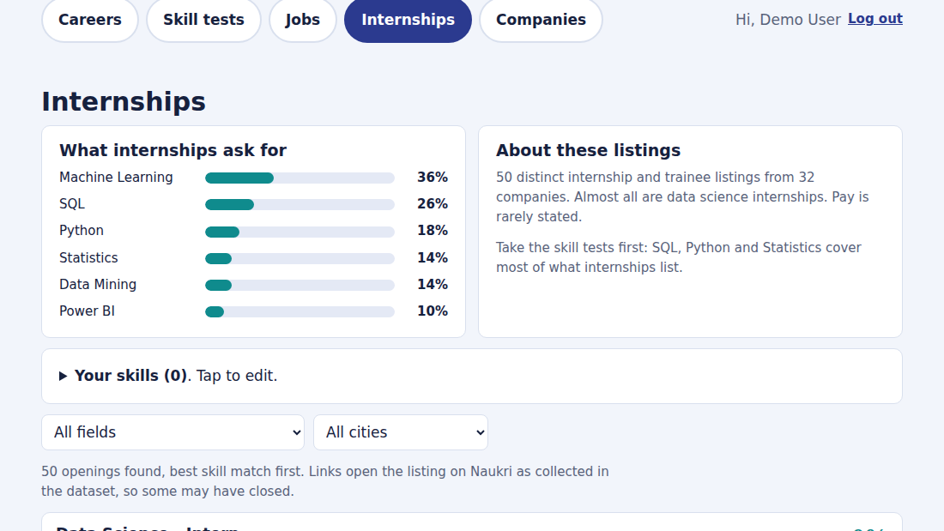
SAMPLE OUTPUT: INTERNSHIPS PAGE
5

Slide 14
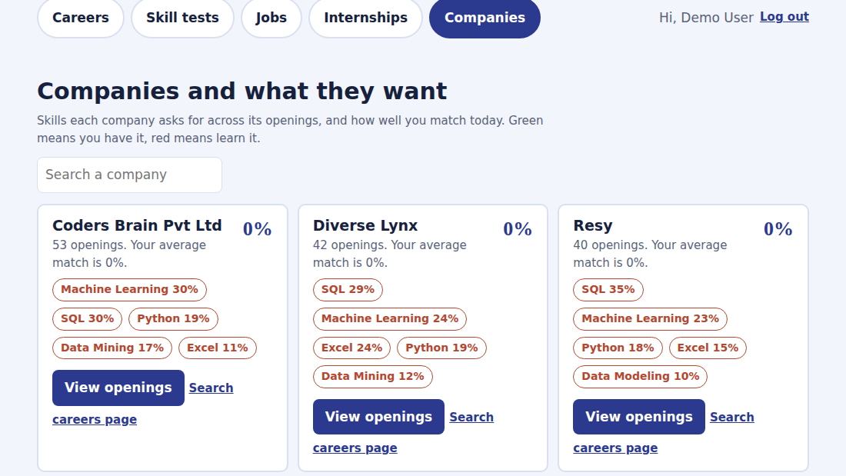
SAMPLE OUTPUT: COMPANIES PAGE
5

Slide 15
Benefits and Limitations
How the results should be used
Benefits
• Highlights frequently requested skills
• Compares job opportunities by location
• Summarizes available salary information
• Helps students explore relevant career paths
The project supports career exploration; it does not guarantee a job or salary.
9

Slide 16
CONCLUSION
AI & TECH JOB MARKET ANALYSIS
The project combines Python, SQL, Power BI and web development to turn job postings into understandable insights for students and job seekers.
THANK YOU
Vishali K | 2025MCA58

